Slide 1
BREAST CANCER DETECTION (BCD) USING MACHINE LEARNING
Group Number: 62
Team Members:
Deepashri Dabhade 21BAI10325
Shaunak Abhonkar 21BAI10348
Aaditya More 21BAI10014
Aniruddha Joshi 21BAI10189
Meet Joysar 21BAI10063
Under the Guidance and Counselling of:
Dr. Komarasamy G. Sir
Review -3

Slide 2
Contents
Sr. No. | Topic | Slide no.
1. | Abstract | 3
2. | Objectives | 4
3. | Introduction | 5
4. | Literature Work | 6-11
5. | Existing Work | 12
6. | Proposed Work | 13-14
7. | System Flow Diagram | 15
8. | Hardware & Software | 16
9. | Experimental results | 17-19
10. | Conclusion & Future Work | 20
11. | Reference | 21
12. | Teammates and Contribution | 22

Slide 3
ABSTRACT
Breast cancer develops in the tissue of the breast
Men are less likely than women to develop breast cancer
Indications of breast cancer include breast lumps, bloody nipple discharge, and changes in nipple or breast texture
Treatment for breast cancer is determined by its stage and may include chemotherapy, radiation, hormone replacement treatment, and surgery
This project aims to develop a machine learning model to classify breast cancer as benign or malignant
The algorithm used for the model includes logistic regression, decision tree, and random forest.

Slide 4
OBJECTIVE
Objective of the project is to develop a machine learning model for the detection of breast cancer
Comparison of different algorithms (logistic regression, decision trees, and random forest) will be done
The aim is to identify the most accurate and efficient algorithm for breast cancer detection
To evaluate the performance of the model using various metrics such as accuracy, precision, recall, and F1-score.

Slide 5
Introduction
Breast cancer is a common type of cancer among women worldwide
Early detection is crucial for effective treatment and survival rates
Current methods for breast cancer detection have limitations in terms of accuracy and accessibility
Machine learning can analyze large amounts of data and identify patterns that may not be visible to the human eye
The project aims to detect breast cancer using various machine learning algorithms
The project will discuss the dataset, performance evaluation metrics, results, and future work

Slide 6
Literature Work
S.No. | Title of the paper | Journal Name, Publisher Name, Year of Publication and Volume & Issue Number (only SCI) | Author Name | Problem addressed/ Problem Statement | Methods/Technologies used | Author Contribution | Shortcoming/ Assumption Made
 | An Automatic Detection of Breast Cancer Diagnosis and Prognosis Based on Machine Learning Using Ensemble of Classifiers | IEEE Access (Vol 10), IEEE, 12 May 2022, Funding Agency: Technology Development Program of MSS, National Research Foundation of Korea (NRF) | Usman Naseem, Junaid Rashid, Liaqat Ali, Jungeun Kim, Qazi Emad Ul Haq, Mazhar Javed Awan, Muhammad Imran | Providing the ML model such that it would have great accuracy with a new approach rather than following the other state-of-the-art methods | #. A classification framework was created using an ensemble of the machine learning classifiers SVM, LR, NB, and DT. | · Presented an ensemble of machine learning-based methods for breast cancer diagnosis and prognosis. | Ø The performance of the classifiers could vary depending on the specific hyperparameter values chosen. It may be beneficial to perform a hyperparameter search in order to find the optimal values for each classifier.

Slide 7
2. | A Review on Recent Progress in Thermal Imaging and Deep Learning Approaches for Breast Cancer Detection | IEEE Access ( Volume: 8), IEEE, 22 June 2020, Funding Agency: Ministry of Education and Culture of the Republic of Indonesia under 2020 Doctoral Research Grant and by Ministry of Research, Technology, and Higher Education of the Republic of Indonesia under 2019 World Class Professor (WCP) Programme | Khairul Munadi, Biswajeet Pradhan,Maimun Syukri, Roslidar Roslidar, Aulia Rahman, Rusdha Muharar, Muhammad Rizky Syahputra, Fitri Arnia | Finding out such ways to diagnose Breast Cancer that do not have any physical contact with body such as Thermography, using NN models to increase it accuracy in prediction of breast cancer thermogram classification | Using thermography for visualization and quantification, facilitating risk-free detection of breast cancer | An summary of breast thermography's potential to detect cancer, including information on the dataset of breast thermograms.. | Improved breast thermogram categorization must be the goal of future research. In order to do this, representative datasets, high-quality ROIs, high-quality kernel assignments, and lightweight CNN models must be used.
3. | Deeply-Supervised Networks With Threshold Loss for Cancer Detection in Automated Breast Ultrasound | IEEE Transactions on Medical Imaging ( Volume: 39, Issue: 4, April 2020) Funding Agency: National Natural Science Foundation of China, Medical Science and Technology Foundation of Guangdong Province, Natural Science Foundation of SZIJ | Yi Wang, Na Wang, Min Xu, Junxiong Yu, Chenchen Qin, Xiao Luo, Xin Yang, Tianfu Wang, Anhua Li, and Dong Ni | Improve the network architecture for automatic cancer detection in ABUS, in order to accelerate the reviewing and meanwhile to obtain high detection sensitivity with low false positives | efficiently using multi-layer features to increase the detection sensitivity with a densely deep supervision method. | A more effective network design. To systematically combine multi-scale contextual information and increase the detection sensitivity for tiny lesions, we use 3D dilated convolutions. | fatty masses and cystic lesions would be mistaken for malignant tumours.

Slide 8
4. | Deep Learning Assisted Efficient AdaBoost Algorithm for Breast Cancer Detection and Early Diagnosis | Published in: IEEE Access ( Volume: 8) Date of Publication: 08 May 2020 Funding Agency: 10.13039/501100012151-Sanming Project of Medicine in Shenzhen (Grant Number: SZSM201811073) | Jing Zheng, Denan Lin, Zhongjun Gao, Shuang Wang, Mingjie He, And Jipeng Fan | The improvement of the prediction of tumor prognosis and the improvement of a deeper classification of results in breast cancer detection | Deep Learning assisted Efficient Adaboost Algorithm (DLA-EABA) for breast cancer detection has been proposed. | · Proposed the deep learning assisted efficient Adaboost algorithm for breast cancer detection and early diagnosis. | More testing is required and the model is tedious and extremely time consuming.
5. | Spectral Capacitively Coupled Electrical Resistivity Tomography for Breast Cancer Detection | Published in: IEEE Access ( Volume: 8) Date of Publication: 11 March 2020 Funding Agency: 10.13039/501100000835-University of Bath Catherine and Raoul Hughes | Gege Ma and Manuchehr Soleimani | An alternative for traditional EIT medical use is proposed | This work focuses on the introduction and the evaluation of a spectral capacitively-coupled electrical resistivity tomography (CCERT) for breast cancer diagnosis. | The author introduces a new type of contactless measurement modality (CCERT) with the multi-frequency method for breast cancer imaging. | The frequency-difference imaging produced by the the CCERT method is affected by skin effects and fringing effects in the laboratory environment, which can influence the signal strength and accuracy of the reconstructed conductivity spectra.

Slide 9
6. | Breast Cancer Detection using Multimodal Time Series Features from Ultrasound Shear Wave Absolute Vibro-Elastography | Published in: IEEE Journal of Biomedical and Health Informatics ( Volume: 26, Issue: 2, February 2022) Date of Publication: 10 August 2021 Funding Agency: University of British Columbia Clinical Canadian Institutes of Health Research | Yanan Shao, Hoda S. Hashemi, Paula Gordon, Linda Warren, Jane Wang, Fellow, IEEE, Robert Rohling, Fellow, IEEE, and Septimiu Salcudean, Fellow, IEEE | The goal is to ascertain whether S-WAVE can distinguish between benign and malignant breast tissue abnormalities. | In S-WAVE, a controlled shaker is used to excite the tissue in steady-state at different frequencies, and subsequent US RF data frames are captured in a time series. The placenta, prostate, and breast have all been studied using the S-WAVE imaging technology. | The dataset of about 40 patients is being studied and then acted upon with random forest classification techniques. | As the tissue motion is 3D rather than 2D, the 2D S-WAVE data modality employed in the study could lead to inaccuracies in determining quantitative elasticity.
7. | Enhancement of Penetration of Millimeter Waves by Field Focusing Applied to Breast Cancer Detection | Published in: IEEE Transactions on Biomedical Engineering ( Volume: 68, Issue: 3, March 2021) Date of Publication: 04 August 2020 | Ioannis Iliopoulos, Simona Di Meo, Marco Pasian, Maxim Zhadobov, Philippe Pouliguen, Patrick Potier, Luca Perregrini, Ronan Sauleau, and Mauro Ettorre. | The potentialities of improving the penetration of millimeter waves for breast cancer imaging are here explored. | A field focusing technique based on a convex optimization method. Field propagation inside the breast model. | A focusing technique based on convex optimization has been used here to increase the penetration in breast cancer imaging scenarios at millimeter waves. | No particular shortcomings were detected.

Slide 10
8. | Deep Neural Networks Improve Radiologists’ Performance in Breast Cancer Screening | N. Wu et al., "Deep Neural Networks Improve Radiologists’ Performance in Breast Cancer Screening," in IEEE Transactions on Medical Imaging, vol. 39, no. 4, pp. 1184-1194, April 2020 | Nan Wu; Jason Phang; Jungkyu Park; Yiqiu Shen; Zhe Huang; Masha Zorin | They offer a deep convolutional neural network trained on over 2,00000 exams for the classification of breast cancer screening exams (over 1000000 images). When put to the test on the screening population, their network successfully predicts the existence of breast cancer with an AUC of 0.895. | Pretraining the network is useful for improving the performance of the models, as demonstrated by an evaluation employing a task with a similar objective but a noisier result (screening BI-RADS classification). | Show that it is possible to train and test the network using more than 1,000,000 high-resolution mammograms, which is a very sizable data set for medical imaging and not just for breast cancer screening. | Although multicenter studies have shown that modern CAD applications do not increase radiologists' diagnostic ability, radiologists frequently utilise traditional computer-aided detection (CAD) in mammography to help with picture interpretation.
9. | A Novel Hybrid K-Means and GMM Machine Learning Model for Breast Cancer Detection | P. E. Jebarani, N. Umadevi, H. Dang and M. Pomplun, "A Novel Hybrid K-Means and GMM Machine Learning Model for Breast Cancer Detection," in IEEE Access, vol. 9, pp. 146153-146162, 2021 | P. Esther Jebarani; N. Umadevi; Hien Dang; Marc Pomplun | This study demonstrates the methodology's adaptability by combining cutting-edge segmentation techniques with machine learning techniques, two emerging fields of study. | By suggesting a new parameter for assessing the performance of K-means and a Gaussian mixture model (GMM), this research significantly advances the field. On breast cancer, a hybrid mix of segmentation and detection was used. | A hybrid technique for detecting breast cancer is part of the novel notion in this work, and multi-variant analysis is used to raise the suggested system's prediction rate. | It is a difficult challenge in research to identify the tumour mass by segmenting the region of interest. Therefore, automated methods and early detection technologies must work together to help radiologists correctly identify breast cancers.

Slide 11
10. | Part Mitosis: A Partially Supervised Deep Learning Framework for Mitosis Detection in Breast Cancer Histopathology Images | M. Sebai, T. Wang and S. A. Al-Fadhli, "PartMitosis: A Partially Supervised Deep Learning Framework for Mitosis Detection in Breast Cancer Histopathology Images," in IEEE Access, vol. 8, pp. 45133-45147, 2020 | Meriem Sebai; Tianjiang Wang; Saad Ali Al-Fadhli | Using a partially supervised deep learning framework, the goal of this paper is to build a technique for the automatic recognition of mitotic patterns from breast cancer histology slides. | Based on two parallel deep fully convolutional networks, we propose an unique partially supervised framework. With the use of a weight transfer function, one of them is trained using weak labels and the other using strong labels. | It is quite difficult to identify hand-crafted traits that can effectively distinguish mitoses from imitators due to the diversity of the morphologies of the mitosis and the strong similarity between mitotic and non-mitotic cells. | The weighted sum of the weak segmentation branch predictions and the strong segmentation branch predictions represents the final detection findings.

Slide 12
Existing Work
Existing Work:
Previous studies have used machine learning techniques such as decision trees, random forests, and neural networks for breast cancer detection using mammography images as well as other modalities such as ultrasound and MRI.
Some studies have also used patient information such as age, family history, and genetics as additional features for prediction.
Research gap:
Despite the high accuracy rates reported in some studies, the generalizability and interpretability of the models are limited.
There is a need for continued research in this area to improve the accuracy and accessibility of breast cancer detection.
Our study aims to address this research gap by using various regression algorithm and analyzing the performance of the models.

Slide 13
Proposed Work
Based on our objective statement, we will be developing machine learning models using logistic regression, decision trees and random forest algorithms for the early detection of breast cancer.
Uniqueness: Our proposed work is unique in that we will be comparing the results of these three different algorithms to determine which algorithm performs best in terms of accuracy, precision, recall and F1-score.
Modules :
Data preprocessing: Cleaning and preparation of the dataset for training and testing the models.
Model development: Using logistic regression, decision trees and random forest algorithms to train the models on the dataset.
Performance evaluation: Using metrics such as accuracy, precision, recall, and F1-score to evaluate the performance of the models.
Results and discussion: Presentation of the results and discussion of the findings, and comparison of the performance of the three algorithms.

Slide 14
Proposed Work
Steps:
Collecting the dataset of breast cancer and patient information.
Preprocessing and cleaning the dataset.
Splitting the dataset into training and testing sets.
Training logistic regression, decision tree and random forest models on the training dataset.
Testing the models on the testing dataset.
Evaluating the performance of the models using various evaluation metrics.
Presenting the results and discussing future work, and comparing the results of the three algorithms.
Overall, our proposed work aims to improve the accuracy and accessibility of breast cancer detection by comparing the results of three different algorithms and determining which algorithm performs best.

Slide 15
System Flow Diagram
Input .csv file
Logistic Regression
Decision tree
Data Processing
Model Report
Random Forest
Classifiers
Ridge Classifier
Output Classification: Benign / Malignant
Functions trained on data.csv
Support Vector Classifier

Slide 16
Software and Hardware
S.No | Hardware used | Justification
1 | Laptop (Used : Ryzen 7 5800H, RAM : 8GB, SSD : 256GB ) | Development and Testing of the model portability
S.No | Software used | Justification
1 | Python 3.6.9 from Google Collaboratory | Google colab pre-includes the Scipy, Numpy, Pandas, Sklearn, Matplotlib and various Machine Learning libraries. It also gives us a free virtual machine on cloud with capabilities of training ML models

Slide 17
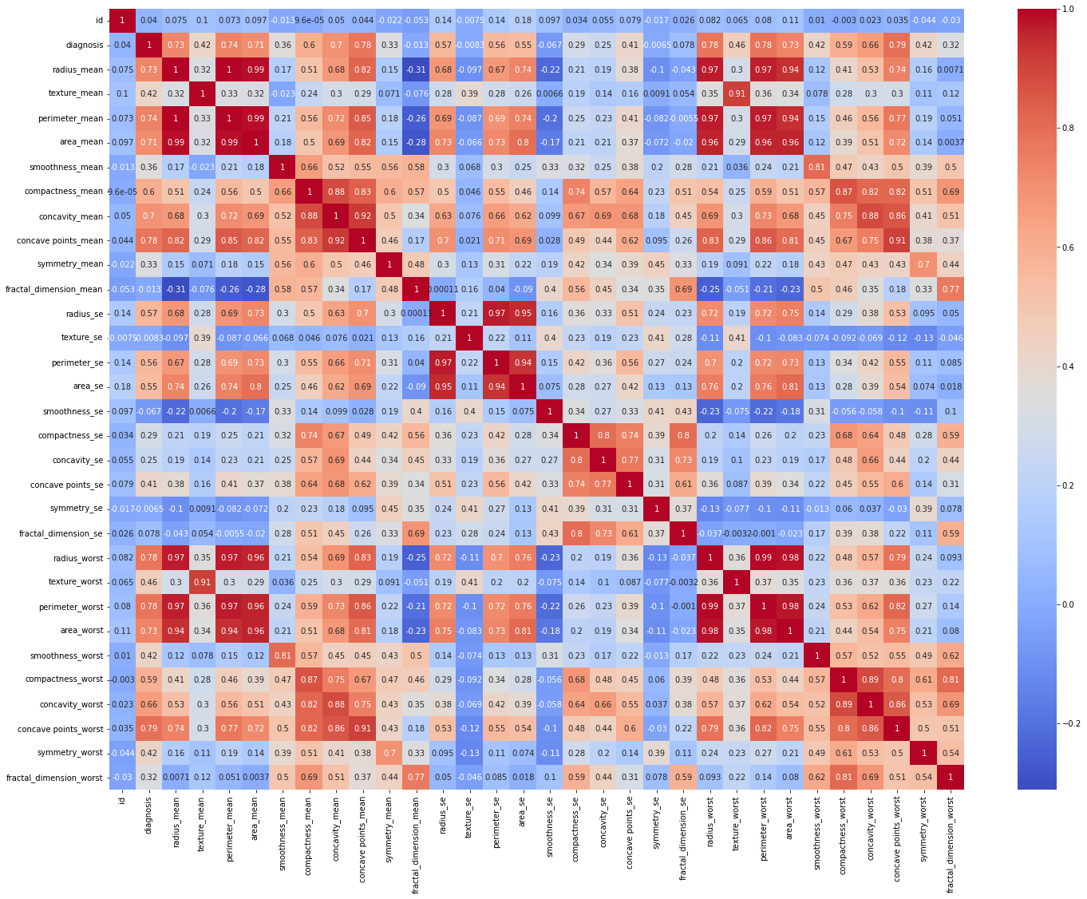
Experimental results
Correlation in heatmap

Slide 18
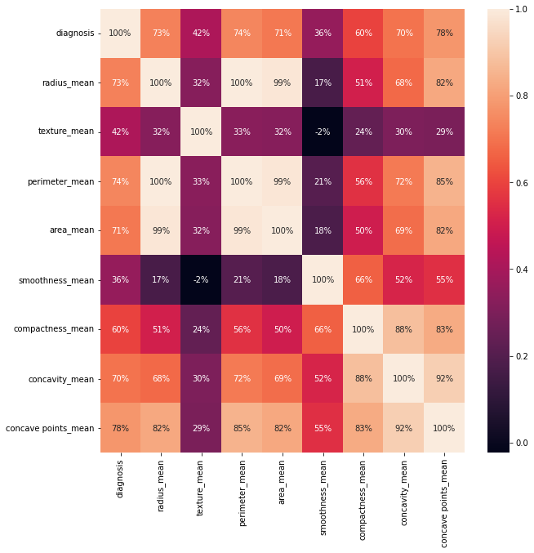
Experimental results

Slide 19
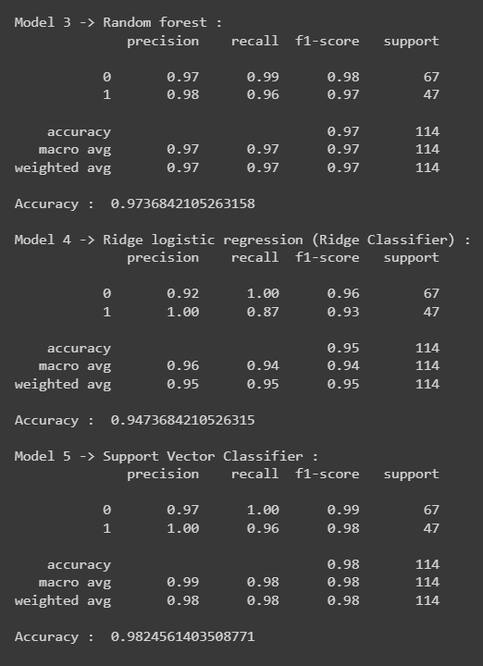
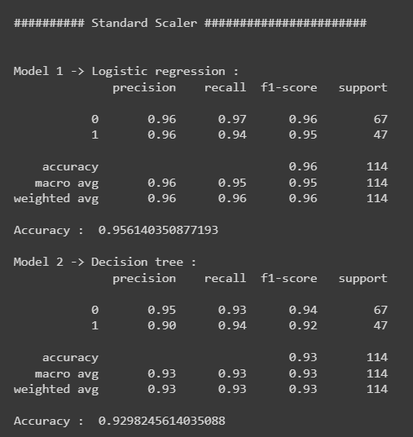
Experimental results
Standard Scaler

Slide 20
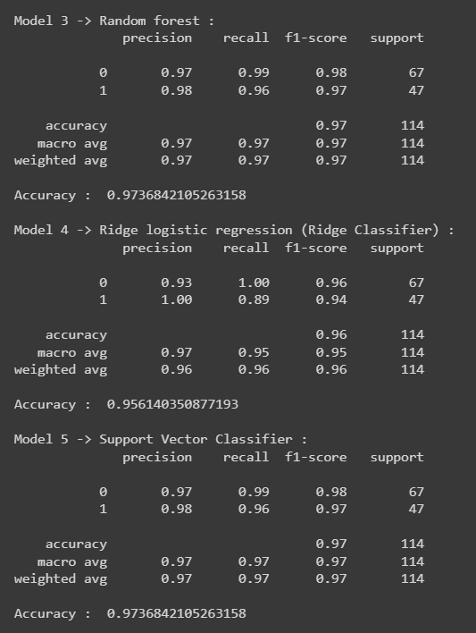
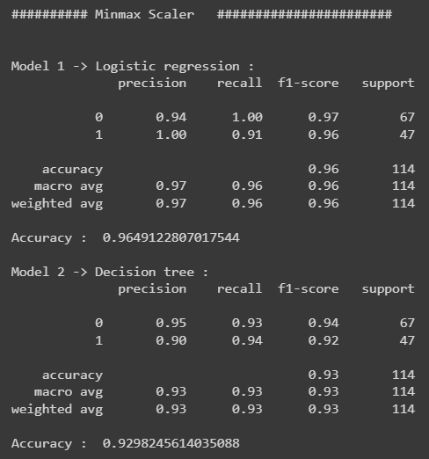
Experimental results
MinMax Scaler

Slide 21
Conclusion & Future Work
Based on our problem statement, we are have trying to develop machine learning models using logistic regression, decision trees and random forest algorithms for the early detection of breast cancer.
The achievements for our model are the accuracy from all the classifier functions which are overall on and above 93%, (one of the model has even achieved the accuracy of 98%) also the usability of our model is very user-friendly and is way simpler then the existing work.
For the part of Future enhancements, we currently take input as .csv file which can be replaced with mammography images.

Slide 22
References
Yanan Shao, Hoda S. Hashemi, Paula Gordon, Linda Warren, Jane Wang, Fellow, IEEE, Robert Rohling, Fellow, IEEE, and Septimiu Salcudean, “Breast Cancer Detection using Multimodal Time Series Features from Ultrasound Shear Wave Absolute Vibro-Elastography”, Published in: IEEE Journal of Biomedical and Health Informatics Volume: 26, Issue: 2, February 2022, DOI: 10.1109
Ioannis Iliopoulos, Simona Di Meo, Marco Pasian, Maxim Zhadobov, Philippe Pouliguen, Patrick Potier, Luca Perregrini, Ronan Sauleau, and Mauro Ettorre, “Enhancement of Penetration of Millimeter Waves by Field Focusing Applied to Breast Cancer Detection”, Published in: IEEE Transactions on Biomedical Engineering ( Volume: 68, Issue: 3, March 2021), ISSN: 1245-41508,DOI: 23.1765
Nan Wu; Jason Phang; Jungkyu Park; Yiqiu Shen; Zhe Huang; Masha Zorin, “Deep Neural Networks Improve Radiologists’ Performance in Breast Cancer Screening”, N. Wu et al., "Deep Neural Networks Improve Radiologists’ Performance in Breast Cancer Screening," in IEEE Transactions on Medical Imaging, vol. 39, no. 4, pp. 1184-1194, April 2020, ISSN: 2169-3536,DOI: 10.1109
P. Esther Jebarani; N. Umadevi; Hien Dang; Marc Pomplun, “A Novel Hybrid K-Means and GMM Machine Learning Model for Breast Cancer Detection”, P. E. Jebarani, N. Umadevi, H. Dang and M. Pomplun, "A Novel Hybrid K-Means and GMM Machine Learning Model for Breast Cancer Detection," in IEEE Access, vol. 9, pp. 146153-146162, 2021
Meriem Sebai; Tianjiang Wang; Saad Ali Al-Fadhli, “Part Mitosis: A Partially Supervised Deep Learning Framework for Mitosis Detection in Breast Cancer Histopathology Images”, IEEE Access, vol. 8, pp. 45133-45147, 2020, ISSN: 2169-3536,DOI: 10.1109

Slide 23
References
Usman Naseem, Junaid Rashid, Liaqat Ali, Jungeun Kim, Qazi Emad Ul Haq, Mazhar Javed Awan,Muhammad Imran, “An Automatic Detection of Breast Cancer Diagnosis and Prognosis Based on Machine Learning Using Ensemble of Classifiers”, IEEE Access (Vol 10), IEEE, 12 May 2022, DOI: 10.1109/ACCESS.2022.3174599, ISSN: 2169-3536
Khairul Munadi, Biswajeet Pradhan,Maimun Syukri, Roslidar Roslidar, Aulia Rahman, Rusdha Muharar, Muhammad Rizky Syahputra, Fitri Arnia, “A Review on Recent Progress in Thermal Imaging and Deep Learning Approaches for Breast Cancer Detection”, IEEE Access ( Volume: 8), IEEE, 22 June 2020, ISSN: 2169-3536, DOI: 10.1109
Yi Wang, Na Wang, Min Xu, Junxiong Yu, Chenchen Qin, Xiao Luo, Xin Yang, Tianfu Wang, Anhua Li, and Dong N, “Deeply-Supervised Networks With Threshold Loss for Cancer Detection in Automated Breast Ultrasound”, doi:10.1109
Jing Zheng, Denan Lin, Zhongjun Gao, Shuang Wang, Mingjie He, And Jipeng Fan, “Deep Learning Assisted Efficient AdaBoost Algorithm for Breast Cancer Detection and Early Diagnosis”, Published in: IEEE Access ( Volume: 8) , 8 May 2020, ISSN: 2169-3536, DOI: 10.1109
Gege Ma and Manuchehr Soleimani, “Spectral Capacitively Coupled Electrical Resistivity Tomography for Breast Cancer Detection”, Published in: IEEE Access ( Volume: 8), 11 March 2020, Electronic ISSN: 2169-3536,DOI: 10.1109

Slide 24
Teammates and Contribution
S.No | Roll No | Name | contribution
1 | 21BAI10325 | Deepashri Dabhade | PPT and Model coding
2 | 21BAI10014 | Aaditya More | PPT and Model coding
3 | 21BAI10063 | Meet Joysar | PPT and Model coding
4 | 21BAI10348 | Shaunak Abhonkar | Gathering Information
5 | 21BAI10189 | Aniruddha Joshi | Gathering Information

Slide 25
THANK YOU!

